Slide 1
KINGS_CONTY HOUSE PRICE PREDICTION
BY: JASWINDER_SINGH

Slide 2
DATA
The data for this project belongs to KAGGLE.
Certain columns are dropped before any use
Outliers were present, removed before modeling

Slide 3
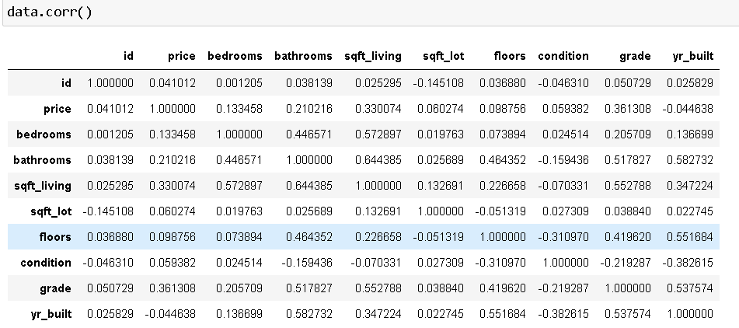
VARIABLES(ATTRIBUTES)

Slide 4
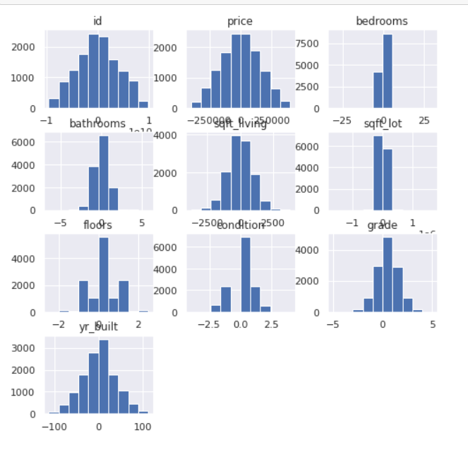
DISTRIBUTION OF THE DATA

Slide 5
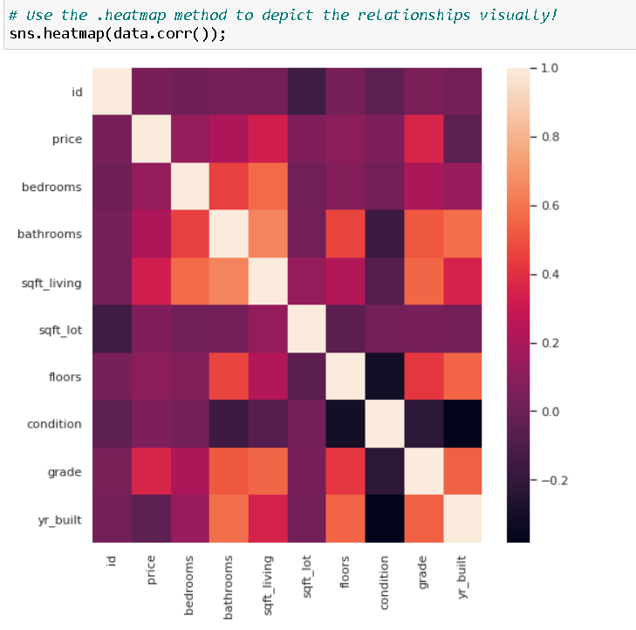
HEATMAP SHOWING THE CORRELATION VISUALLY

Slide 6
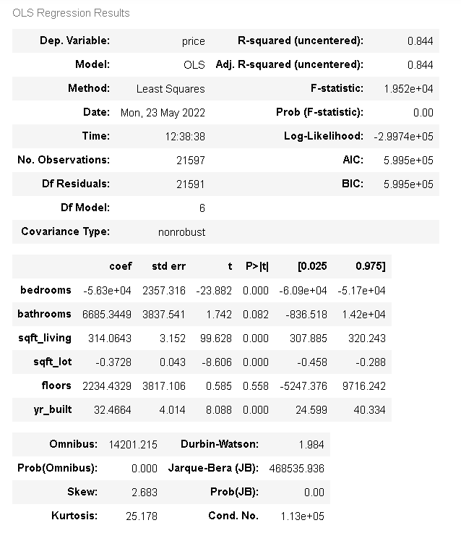
FIRST MODEL SUMMARY
DIFFERENCE IN PREDICTED AND ACTUAL VALUE IS 50K
R2 VALUE IS GOOD BUT NOT SIGNIFICANT
COEFFICIENTS ARE NOT IN DESIRED CONDITON

Slide 7
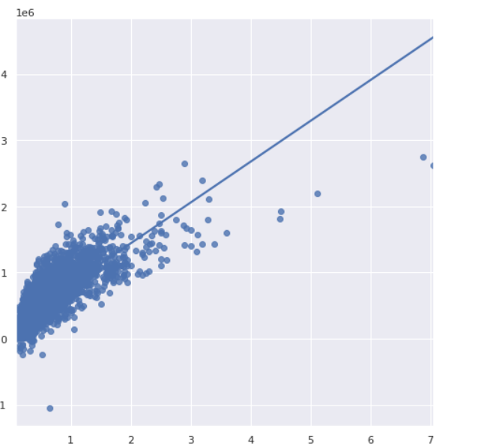
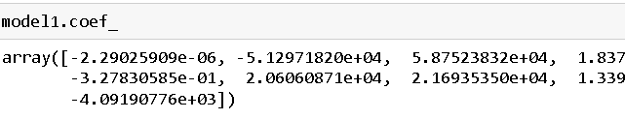
SECOND MODEL
TRAIN/TEST SPLIT BY RATIO 3:7
THE DATA IS DISTRIBUTED IN NON UNIFORM WAY
THE COEF_ ARE NOT BETTER
MODEL SCORE IS NOT DESIRABLE
SHOWING NEGTIVE RELATION AMONG VARIABLES
DIFFERENCE BETWEEN PREDICTED AND ACTUAL VALUE IS ARROUD 35K

Slide 8
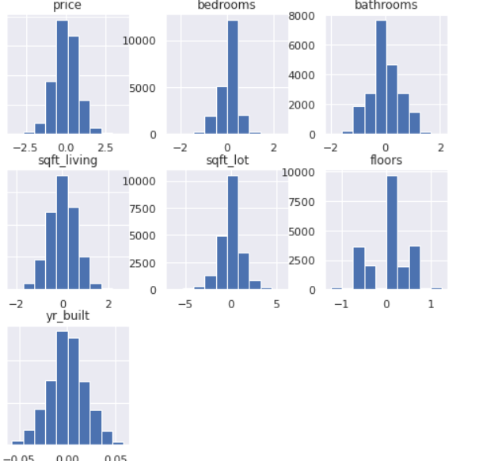
NORMALIZED DISTRIBUTION
THE DISTRIBUTION NOW FOR BEDROOMS AND BATHROOMS ARE MUCH SENSBLE

Slide 9
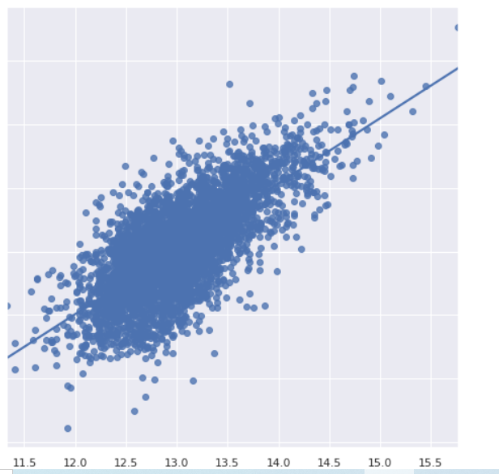
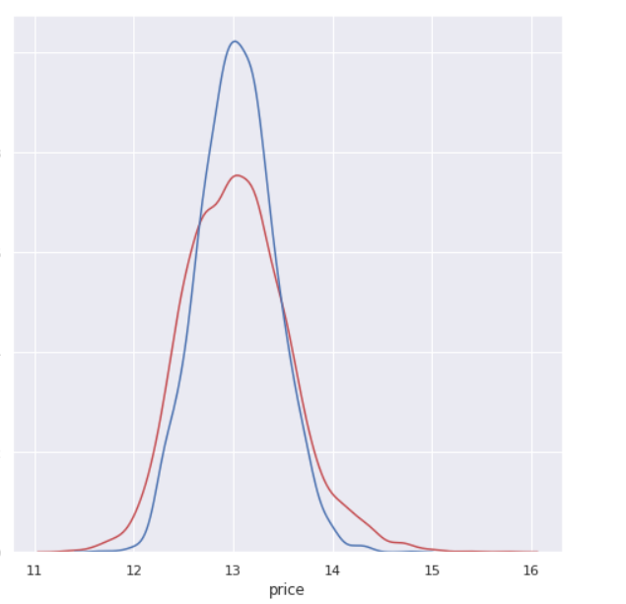

FINAL MODEL TRAIN/TEST SPLIT BY RATION 2:8
THE REGRESSION IS BETTER AND THE POINTS ARE DISTRIBUTED EVENLY
COEFFICINTS ARE BETTER THE PREVIOUS MODELS
POSETIVE REALTION AMONG VARIBALES
R2 VALUE IS GREATER
MODEL SCORE IS DESIRABLE
DIFFERENCE BETWEEN PREDICTED AND ACTUAL VALUE IS ARROUND 30K

Slide 10
THANK YOU

